Slide 1
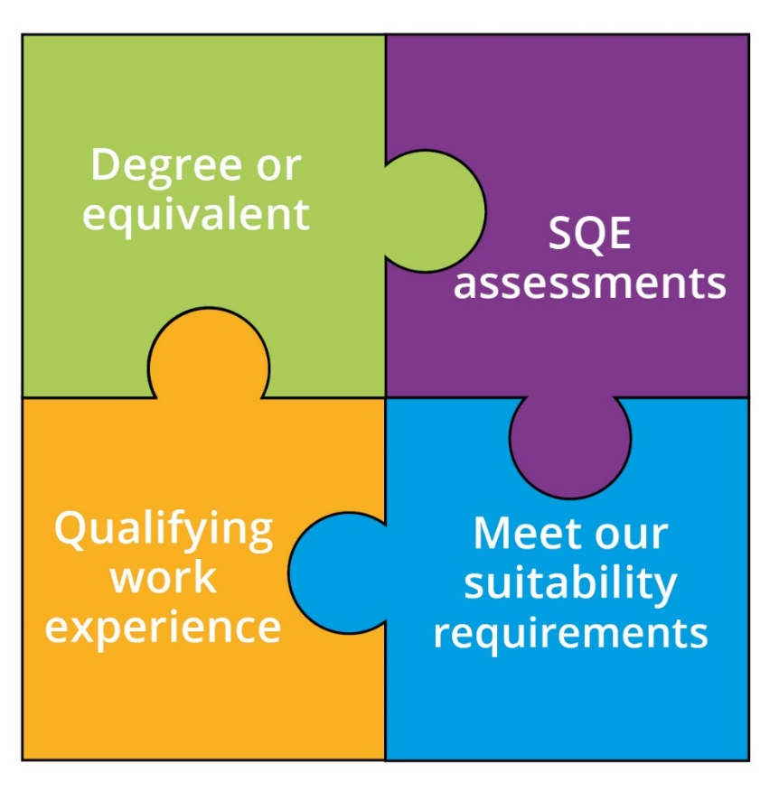
The SQE – a reminder
A single, robust examination
Consistent high standards
We will no longer specify routes to admission
Introduction: September 2021

Slide 2


Transition
If you have started to train under old system, you have choice to continue, or to switch to SQE. In general, last QLD/CPE programmes start autumn 2021. Then, everyone must take SQE.
Details are complex - check them out on our website!

Slide 3





SQE1
Functioning Legal Knowledge
Two 180-question examinations - 10 hours in total
FLK - test ability to identify legal principles and apply them to client problems
and transactions
Unflagged ethics questions throughout

Slide 4
SQE1
Functioning Legal Knowledge
FLK1
FLK2
Business Law and Practice
Dispute Resolution
Contract
Tort
Legal System of England and
Wales
Public Law
Legal Services
Property Law and Practice
Wills and Admin of Estates
Solicitors Accounts
Land Law
Trust
Criminal Law and Practice

Slide 5




SQE2
Practical legal skills assessments
+
16 written and oral tests - 14 hours in total
Simulating tasks carried out by
a solicitor in practice
Tests practical legal skills and functioning legal knowledge equally
Unflagged ethics questions throughout

Slide 6


SQE2
Practical legal skills assessments
Six skills assessed
    Client interviewing and attendance note
    Advocacy
    Case and matter analysis
    Legal research
    Legal writing
    Legal drafting
Across five contexts
Criminal Litigation
Dispute Resolution
Property Practice
Wills and Intestacy, Probate
Administration and Practice
Business organisation rules and procedures

Slide 7




The training market
Variety and choice in solicitor training:
  Traditional delivery, online courses, integration between classroom and work-based learning
  Short focused courses or additional learning
  Trainee, apprenticeship, paralegal models
Closer collaboration between traditional universities and providers of professional legal education and/or law firms
New entrants to the market
Price competition

Slide 8
Qualifying work experience (QWE)
QWE is:
  experience of providing legal services which helps a candidate
  develop some or all of the skills and knowledge set out in the
  Statement of Solicitor Competence
It can be gained:
- in up to four different organisations, in England and Wales, or overseas
QWE must:
- Last for at least two years (full time or equivalent)
- Be confirmed by a COLP/solicitor – they are not ‘signing off’ on competence
Candidates can now register any completed QWE
Notes:
Sign off to confirm completion of QWE, not to assess that standard has been met
Focus on developing the competences in the Statement of Solicitor Competence

Slide 9




Further resources
SQE assessment:
sqe.sra.org.uk
Wider qualification info: sra.org.uk/sqe
SQE webinars:
youtube.com/SRAsolicitors
Subscribe to SQE Update
newsletter: #SQEready

